Slide 1
Dependency Injection
Crystal Tenn
Crystal.Tenn@microsoft.com

Slide 2
What is Dependency Injection (DI)?
Notes:
Benefits of containers include: Density and agility, enabling agile application development and deployment
Don’t mistake Hyper-V container with a VM – containers are much more agile (deploy with a flip of the bits, etc.)

Slide 3

SOLID
ependency Inversion Principle
High-level modules should not depend on low-level modules. Both should depend on abstractions.
Notes:
S=Single Responsibility(a class should have only a single responsibility, only one change to the spec should change the class)
O=Open/Closed (open for extension, but closed for modification)
L=Liskov’s principle (objects in a program should be replaceable with instances of their subtypes without altering the correctness of that program)
I=Interface Segregation (many client-specific interfaces are better than one general-purpose interface)
D=Dependency Inversion Principle means that you should be using interfaces to abstract all of the critical dependencies of a given class.

Slide 4
In other words…
Do not create new objects inside your modules!!!

Slide 5
Violation of the Dependency Inversion Principle
public class MySimpleClass
{
public MySimpleClass()
{
// do some things here
}
public void DoSomething()
{
var logger = new MyLogger();
// do some stuff with the logger
}
}
High-level module
Oops! Using new to create a module
Low-level module
Notes:
Explain the implications on testing this module.
Also, if the MyLogger dependencies changed that would require changes to MySimpleClass

Slide 6
3 Types of DI
There are at least three ways an object can receive a reference to an external module:
constructor injection: the dependencies are provided through a class constructor.
setter injection: the client exposes a setter method that the injector uses to inject the dependency.
interface injection: the dependency provides an injector method that will inject the dependency into any client passed to it. Clients must implement an interface that exposes a setter method that accepts the dependency.

Slide 7
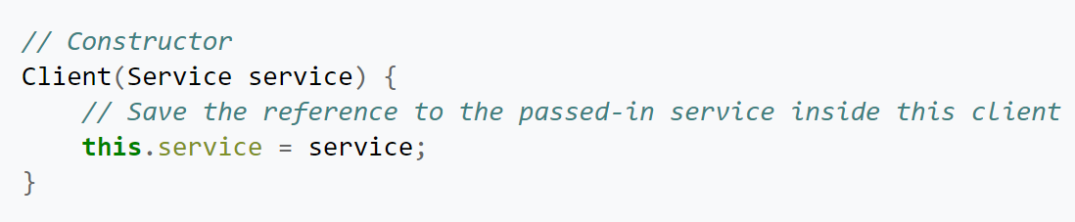
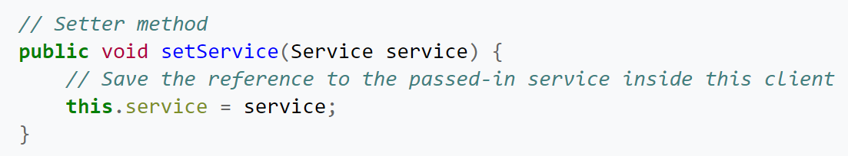
3 Types of DI
constructor injection:
setter injection:

Slide 8
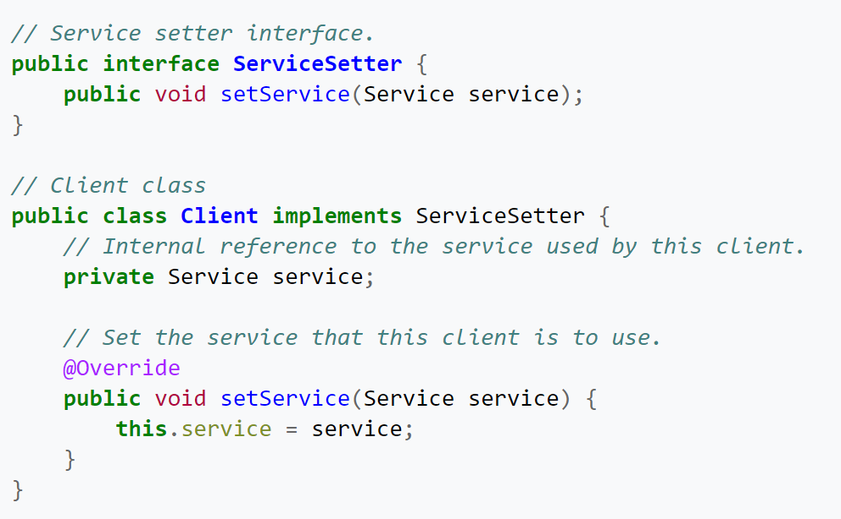
3 Types of DI
interface injection:

Slide 9
Tight Coupling
Component responsible for instantiating dependent classes
Concrete classes “hard-coded” in class
Resistant to change/difficult to test
Change to dependent class can directly affect component
Change to dependent class requires recompiling and testing component
Difficult to quickly swap-out dependent classes for testing and such
Considered liability in your design

Slide 10
How to use DI?
Notes:
Benefits of containers include: Density and agility, enabling agile application development and deployment
Don’t mistake Hyper-V container with a VM – containers are much more agile (deploy with a flip of the bits, etc.)

Slide 11
What’s Wrong with this Component?
Contains 3 dependencies
public class StoreManagerController : Controller
{
private AlbumService _albumService;
private ArtistService _artistService;
private GenreService _genreService;
public StoreManagerController()
{
_albumService = new AlbumService();
_genreService = new GenreService();
_artistService = new ArtistService();
}
Has direct control over creating dependencies
Component communicates with concrete classes
Relationship said to be “Tightly Coupled”
Notes:
Check understanding

Slide 12
Reduce coupling by removing dependencies
public class StoreManagerController : Controller
{
public StoreManagerController()
{
AlbumService _albumService = ???????
GenreService _genreService = ???????
ArtistService _artistService = ???????
}
}
How do these get filled in?
Notes:
There are 3 patterns for accomplishing this: Factory, Service Locator, and Dependency Injection

Slide 13
Patterns for removing dependencies
Three approaches:
Factory
Service Locator
Dependency Injection
Another class is
responsible for
creating objects
Factory
Caller invokes and
requests dependency
Service Locator
Dependency
Injection
Container Injects
dependency into class
Notes:
Factories, Service Locators, and Dependency Injection
Factories, service locators, and dependency injection are all approaches you can take to move the responsibility for instantiating and managing objects on behalf of other client objects.
Factory and Service Locator both require a class that you use to do a lookup to create an instance of the dependency you need.
That would occur inside the class. We'll look at this later, but now focus on dependency injection.

Slide 14
Reducing Coupling – Option 1
public class StoreManagerController : Controller
{
private readonly AlbumService _albumService;
private readonly ArtistService _artistService;
private readonly GenreService _genreService;
public StoreManagerController()
{ _albumService = FactoryOrServiceLocator.CreateAlbumService();
_genreService = FactoryOrServiceLocator.CreateGenreService();
_artistService = FactoryOrServiceLocator.CreateArtistService();
}
}
The factory or service locator knows how to create the instance
Notes:
Pseudocode. We'll look at the factory and service locator later in more detail.

Slide 15
Reducing Coupling – Option 2
Move responsibility for instantiating dependency classes from component to consuming code
Component receives dependencies from calling class via constructor
public class StoreManagerController : Controller
{
private readonly AlbumService _albumService;
private readonly ArtistService _artistService;
private readonly GenreService _genreService;
public StoreManagerController(AlbumService albumService,
GenreService genreService, ArtistService albumService)
{
_albumService = albumService;
_genreService = genreService;
_artistService = artistService;
}

Slide 16
Constructor Injection
Doing so inverts control
Dependency class instantiation moved outside of component and performed by the consuming code
Component relieved of responsibility of instantiating dependency classes
Two problems still persist:
Calling class now more complex (select, instantiate and inject dependent classes)
Component still tightly-coupled to concrete classes

Slide 17
Embrace abstractions
Define dependencies as interfaces
Constructor arguments (or properties)
Calling class passes the instances
Use DI container to do this automatically
Unit test pass in Mocks
A test version of the class

Slide 18
Reduce Coupling Further
Add abstraction layer between component and dependencies by implementing interfaces
Component now unaware of concrete class
Interface references
public class StoreManagerController : Controller
{
private readonly IAlbumService _albumService;
private readlonly IArtistService _artistService;
private readonly IGenreService _genreService;
public StoreManagerController(IAlbumService albumService,
IGenreService genreService, IArtistService albumService)
{
_albumService = albumService;
_genreService = genreService;
_artistService = artistService;
}
Communicates with concrete class via an interface

Slide 19
Refactoring to Interfaces
Component dependent on interfaces
Not aware of concrete class
Communicates with interface
Talks to any reference that implements interface
Inject different implementations of dependent class without modifying component
Facilitates testing
Pass fake implementations for unit testing

Slide 20
Loose Coupling
Implement Interfaces to communicate across layers -- enforces loose coupling
A layer should not expose internal details on which another layer could depend
Controller, Services, Repositories all loosely coupled with interface references
One Layer can Mock or Fake another layer to isolate functionality, enabling testability across each layer
IService
IRepository
Controller
Service
Repository
Controller has dependency on Service - interface-based
Service has dependency on Repository - interface-based
Repository has dependency on DbContext

Slide 21
Compare the main DI frameworks Performance

Slide 22
Compare the main DI frameworks
Mef
Mef2
Unity
Ninject
Castle Windsor
Autofac
StructureMap
Performance comparisons:
https://github.com/danielpalme/IocPerformance
http://www.palmmedia.de/Blog/2011/8/30/ioc-container-benchmark-performance-comparison

Slide 23
Compare the main DI frameworks
Microsoft released three versions of MEF using two only unique names: MEF and MEF2
System.ComponentModel.Composition.* MEF in .NET 4 (typically called just MEF), no support for CompositionScopes, ExportFactories, etc
System.ComponentModel.Composition.* MEF2 in .NET 4.5 (sometimes called MEF2 or MEF), support for composition scopes, ExportFactories
System.Composition.* from independent package Microsoft.Composition lightweight version of MEF typically called MEF2
The benchmark site refers to lightweight MEF2 System.Compostion.* from Microsoft.Composition package.

Slide 24
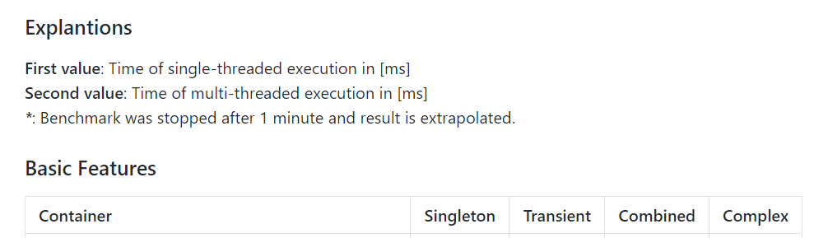
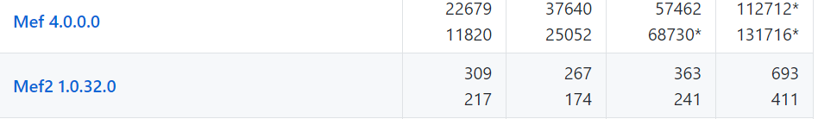
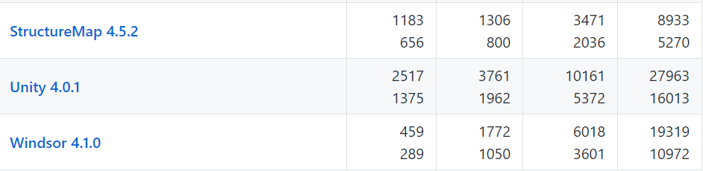
Singleton: Objects with is singleton lifetime are resolved
Transient: Objects with is transient lifetime are resolved
Combined: Objects with two dependencies (singleton and transient lifetime) are resolved
Complex: Objects with several nested dependencies are resolved
Mef2, Autofac, StructureMap, and Castle Windsor and are the fastest DI frameworks, though it depends on what type of objects.
Mef, Unity, and Ninject are the slowest.
Notes:
https://github.com/danielpalme/IocPerformance
http://www.palmmedia.de/Blog/2011/8/30/ioc-container-benchmark-performance-comparison

Slide 25
Compare the main DI frameworks
https://github.com/danielpalme/IocPerformance
http://www.palmmedia.de/Blog/2011/8/30/ioc-container-benchmark-performance-comparison

Slide 26
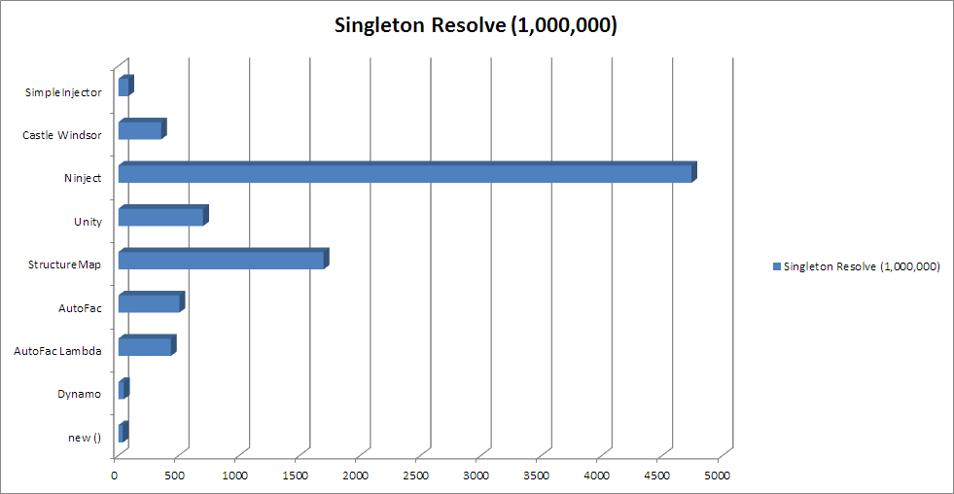
https://cardinalcore.co.uk/2015/01/28/ioc-battle-in-2015-results-using-ninject-think-again/
Notes:
https://cardinalcore.co.uk/2015/01/28/ioc-battle-in-2015-results-using-ninject-think-again/

Slide 27
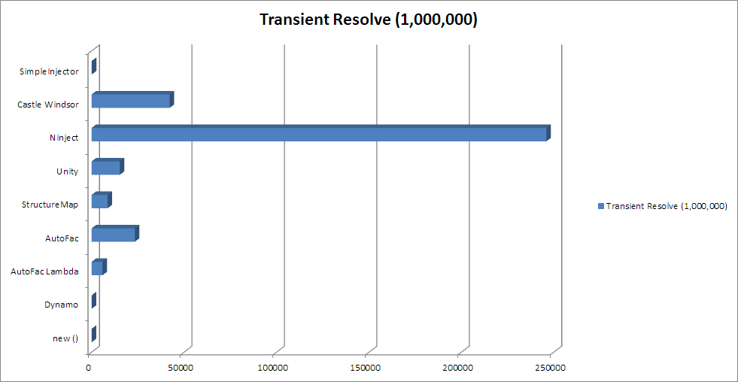
https://cardinalcore.co.uk/2015/01/28/ioc-battle-in-2015-results-using-ninject-think-again/
Notes:
https://cardinalcore.co.uk/2015/01/28/ioc-battle-in-2015-results-using-ninject-think-again/

Slide 28
Mef
Crystal Tenn
Crystal.Tenn@microsoft.com

Slide 29
Managed Extensibility Framework What is it?
The Managed Extensibility Framework (MEF) is a new library in the .NET Framework that enables greater reuse of applications and components. Using MEF, .NET applications can make the shift from being statically compiled to dynamically composed.
Notes:
Managed Extensibility Framework (MEF) is a component of .NET Framework 4.0 for creating lightweight, extensible applications. It allows application developers to discover and use extensions with no configuration required. It also lets extension developers easily encapsulate code and avoid fragile hard dependencies. MEF not only allows extensions to be reused within applications, but across applications as well. MEF was introduced as a part of .NET 4.0 and Silverlight 4. It is available on CodePlex along with source and as a result can be used, albeit unsupported and with limitations, on earlier releases of .NET.

Slide 30

MEF Basics…
An Application is built of parts.
Notes:
Parts are the lego blocks. You make these available for the application to consume.
Roughly speaking, MEF's core consists of a catalog and a CompositionContainer. A catalog is responsible for discovering extensions and the container coordinates creation and satisfies dependencies.

Slide 31
MEF Basics…
Export it.
Import it.
Compose it.
Notes:
This is all you need to know for MEF.
EXPORT – publish/declare a part available
IMPORT – consume/require a part to be available to my app. The app doesn’t know who will fulfill the requirement. It just declares the requirement.
COMPOSE – Containers provide all the parts available that meet declared requirements and the app puts them together and consumes them. They might come from the file system, the network or the web, etc.

Slide 32
Part, enter stage left…
public class SimpleMortgageCalculator : IMortgageCalculator
{
public ILogger Logger { get; set; }
public float Calculate()
{
Logger.Log("Calculating Mortgage");
return ...;
}
}
Part
A

Slide 33
Export
[Export(typeof(IMortgageCalculator))]
public class SimpleMortgageCalculator : IMortgageCalculator
{
public ILogger Logger { get; set; }
public float Calculate()
{
Logger.Log("Calculating Mortgage");
return ...;
}
}
Part
A

Slide 34
Importit…
[Export(typeof(IMortgageCalculator))]
public class SimpleMortgageCalculator : IMortgageCalculator
{
[Import(typeof(ILogger))]
public ILogger Logger { get; set; }
public float Calculate()
{
Logger.Log("Calculating Mortgage");
return ...;
}
}
Part
A

Slide 35
Compose it.
Catalogs provide the parts.
Catalog
Notes:
2 moving parts for composition
Catalogs = provides the parts from some source
On next slide

Slide 36
Compose it.
Container is the matchmaker.
Catalog
Notes:
2 moving parts for composition
Catalogs = provides the parts from some source
Containers – gets all the parts from the containers and matches all the Exports & Imports

Slide 37


Catalog Categories.
Aggregating Catalog
Directory Catalog
Assembly Catalog
Type Catalog
Notes:
Out of the box we provide a few catalogs
TypeCatalog – explicitly register a type
AssemblyCatalog – find parts in the assembly
DirectoryCatalog – find parts in assemblies in a directory
AggregatingCatalog – combine the other catalog types together into a single catalog
Can also make custom catalogs

Slide 38
Metadata…
[Export(typeof(IMortgageCalculator))]
[ExportMetadata(“Calculation”, “Simple”)]
[ExportMetadata(“Tax Aware”, null)]
public class SimpleMortgageCalculator : IMortgageCalculator
{
public ILogger Logger { get; set; }
public float Calculate()
{
Logger.Log("Calculating Mortgage");
return ...;
}
}
Part
A
Notes:
Others things you might want to do – associate metadata with a part

Slide 39
Parts can be lazy…
[Import(typeof(ILogger))]
public ILogger Logger { get; set; }
Part
A
Part
B
Notes:
Lazy loading is delay loading until the type is actually referenced. This can greatly speed up startup time and reduce application footprint

Slide 40
Parts can be lazy…
[Import(typeof(ILogger))]
public ILoggerLazy<ILogger>Logger { get; set; }
Part
A
Lazy
<B>
Notes:
Lazy loading is delay loading until the type is actually referenced. This can greatly speed up startup time and reduce application footprint

Slide 41
The slippery slope…
[Export(typeof(IMortgageCalculator))]
[ExportMetadata(“Calculation”, “Simple”)]
[ExportMetadata(“Tax Aware”, null)]
[ExportMetadata(“This”, “foo”)]
[ExportMetadata(“That”, “bar”)]
Part
A
Notes:
Lots of metadata can quickly get out of hand. Its also not strongly typed.

Slide 42
The slippery slope… solved
[Export(typeof(IMortgageCalculator))]
[ExportMetadata(“Calculation”, “Simple”)]
[ExportMetadata(“Tax Aware”, null)]
[ExportMetadata(“This”, “foo”)]
[ExportMetadata(“That”, “bar”)]
Part
A
[Export(typeof(IMortgageCalculator))]
[CalcCapabilities(
Mode=Complexity.Simple,
TaxAware=true,
This=“foo”,
That=“bar”)]
Notes:
We can have strongly typed metadata in MEF. Reduces complexity of declaration as well as provides strongly typed compile time enforcement of consumption of the metadata.

Slide 43
Lifetime
Non-Shared
Shared
Container
Container
Part A
Part B
Part B
Part B
Notes:
MEF has the ability to export something as a single or multiple instance. Default is same instance.

Slide 44
Dependencies
.\Extensions
Composition Container
Notes:
Lets add a directory where the application will pick up external dependencies. VS 2010 editor uses MEF to compose all the plugins it knows about.

Slide 45
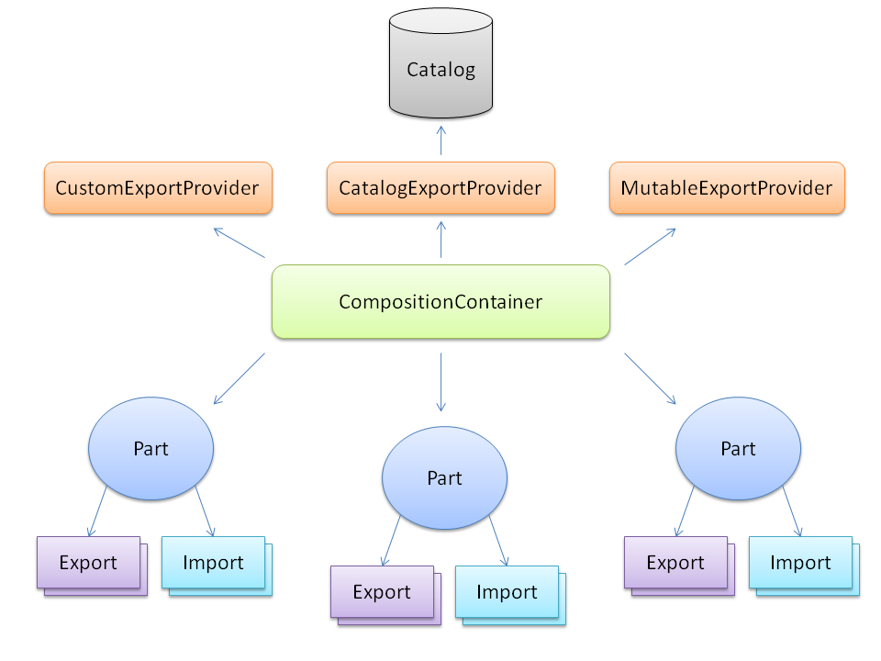
MEF Architecture

Slide 46
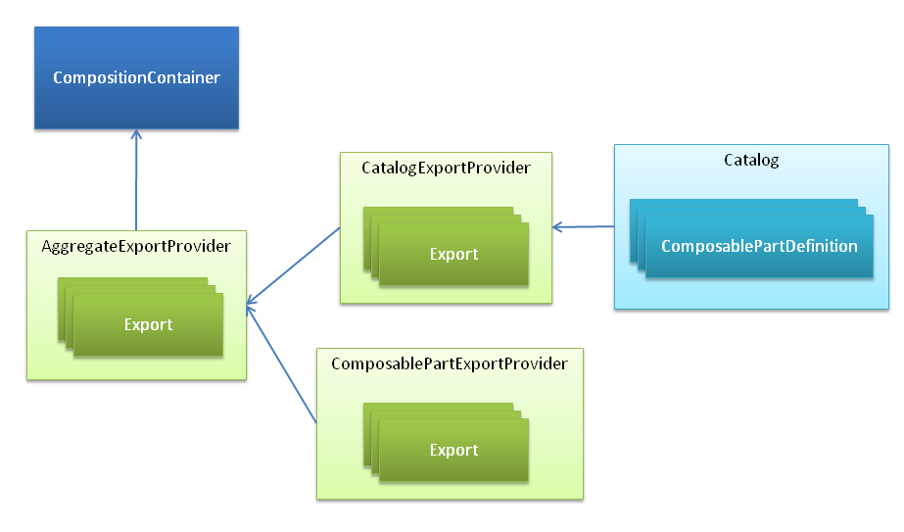
MEF Architecture

Slide 47
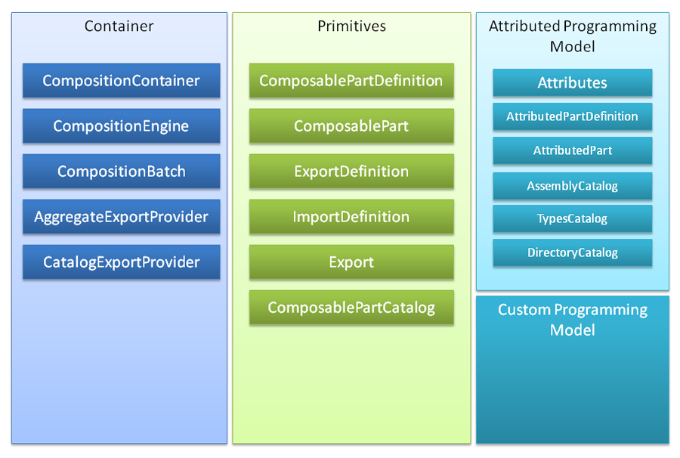
MEF Container

Slide 48
Unity
Crystal Tenn
Crystal.Tenn@microsoft.com

Slide 49
Dependency Injection Lifecycle
Register: tell the container how to instantiate an object
Resolve: instantiate the object
Dispose: object becomes available for garbage collection

Slide 50
Register
var container = new UnityContainer();
container.RegisterType<IMyInterface, MyClass>();
Notes:
Code sample shows how you could create a new Unity container and then register the concrete type to use when an IMyInterface instance is needed

Slide 51
Resolve
var service = container.Resolve<MyController>();
Notes:
Code sample shows how you instantiate an object using the container.
The object could an interface listed in the registrations or could be a class with dependencies that are registered in the container.

Slide 52
Simple Code Example of DI
A asdasdasdasdafor running large-scale parallel and high-performance computing (HPC) applications efficiently in the cloud.
Azure Batch schedules compute-intensive work to run on a managed collection of virtual machines, and can automatically scale compute resources to meet the needs of your jobs.

Slide 53
When NOT to use DI.
Notes:
Benefits of containers include: Density and agility, enabling agile application development and deployment
Don’t mistake Hyper-V container with a VM – containers are much more agile (deploy with a flip of the bits, etc.)

Slide 54
When NOT to use DI
Small projects
It can be overkill for simple small projects and add complexity for no good reason
Functional programs (as opposed to object oriented)
Some legacy applications or pre-existing ones with a difficult architecture
If you try to implement DI’s specific way of layering and decoupling onto an existing old application it could cause problems if the original app was not build with inversion of control in mind.
If you have many junior developers on the team, it could pose an issue and extra confusion to them. Consider taking time out to teach the junior developers how to use this if they will work on a project with DI.

Slide 55
Labs on Dependency Injection Frameworks
Please complete all 3 labs
04a DI with Mef
04b DI with Mef2
04c DI with Unity

Slide 56
Thank you!

